Slide 1

Introduction to Computers

Slide 2
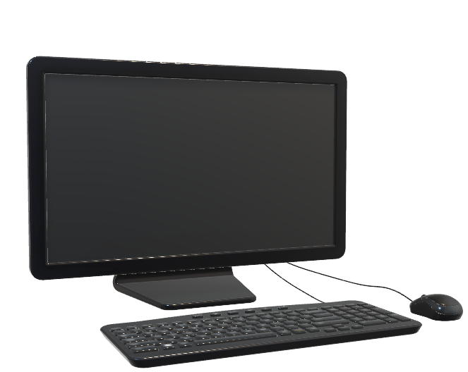
Computer is an electronic machine, operating under the control of instructions stored in its own memory that can accept data (input), manipulate the data according to specified rules (process), produce results (output), and store the results for future use. Technically, a computer is a programmable machine. This means it can execute a list of programmed instructions and respond to new instructions that it is given

Slide 3
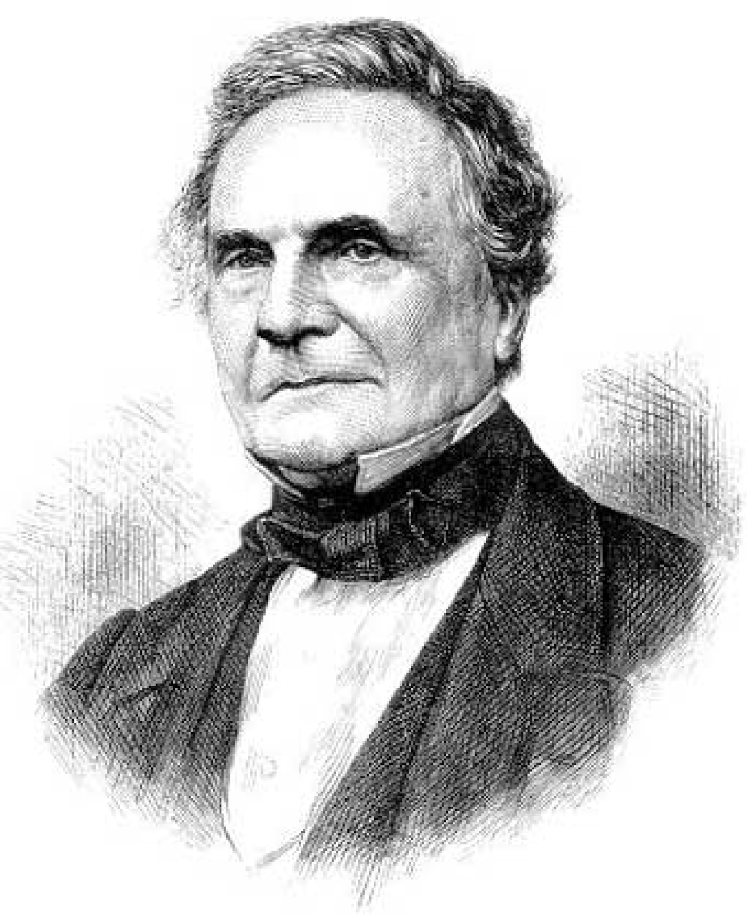
Charles Babbage
The working principles of today's computers were provided by an English mathematician Charles Babbage around 1833's invented the machine called the "Analytical Engine". A machine that could calculate and print tables of functions using limited techniques

Slide 4
First Generation (1946-1954)
Vacuum tubes
Mark I
ENIAC
EDVAC: Electronic Discrete Variable Automatic Computer
EDSAC: Electronic Delay Storage Automatic Computer
UNIVAC-1: Universal Automatic computer

Slide 5
ferrite cores for main memory magnetic disks.
FORTRAN (1956)
ALGOL (1960)
COBOL (1960 - 1961)
Transistor
Second Generation (1955-1964):

Slide 6
Third Generation (1964-1977)
Integrated Circuits (IC)s
VAX-750
IBM-370
ICL-1900
IBM 360
LSI (Large Scale Integration)

